Slide 1


ST.JOSEPH COLLEGE OF ENGINEERING
SRIPERUMBUDUR
Kali Linux Comprehensive Hacker's Toolbox:
A Five-Phase Integrated Solution for Advanced
Penetration Testing and Ethical Hacking
DEPARTMENT: INFORMATION TECHNOLOGY
TEAM MEMBERS:
PROJECT GUIDE:
Mr. S.Karthi,ME.,
Assistant Professor of IT
MAHALAKSHMI V (212920205028)
NOWMIYA J (212920205038)
SHARIKA NOWSHEEN A (212920205049)
TAHA AFREEN A (212920205056)

Slide 2
CONTENTS:
Objective
Motivation
Abstract
Existing System
Proposed System
Literature Survey
Architecture Diagram
Modules
System Requirement
References

Slide 3
OBJECTIVE:
The Main purpose of this project is to facilitate the work of Ethical hackers.
This tool can be handy to the penetration testers and saves a effort as they can focus on various tasks of a penetration test.
Ethical hacking involves an authorized attempt to gain unauthorized access to a computer system, application, or data.
An attacker or an ethical hacker follows the same five-step hacking process to breach the network or system.
This tool is helpful for ethical hackers to penetration testing on system or network.

Slide 4
MOTIVATION:
This tool is very help full for ethical hackers to penetration testing on system or network.
This makes their work easier and reduce their effort
Ethical hackers and penetration testers can easily access the tools need for hacking phases here.
This tool is working on command line interface, so it is very easy for Ethical hacker and penetration testers

Slide 5
Abstract
Ethical hacking is a process of detecting vulnerabilities in an application, system, or organizations infrastructure.
This tool is helpful for ethical hackers to perform penetration testing on system or network. In real life, Ethical Hackers use a lot of tools for penetration testing.
Various tools are used for different kinds of purpose. one of the biggest tasks faced by Ethical Hackers are finding tools.
This task can be intimidating since a lot of time and effort are needed in accomplishing this task.
This tool can be handy to the penetration testers and saves a effort as they can focus on various tasks of a penetration test.

Slide 6
Currently, we have individual tool for phases in hacking to find the vulnerabilities, it takes a lot of time for the user to use separate tool for each hacking phase.
In our project, we have a single tool that includes all the five phases of hacking. In Bug Bounty phase, it has the modules such as Clickjacking, Host Header Injection and URL Redirection checker.
For instance, the first phase is information gathering which as five modules in it. To find the third module, “trace IP’ one need to enter option three and then enter IP address and the tool traces the IP and give the information.
The same procedure is followed to access different phases and its module accordingly.
There are 5 phases in hacking such as reconnaissance, scanning, gaining access, maintaining access and clear tracking.
An attacker or an ethical hacker follows the same five-step hacking process to breach the network or system.

Slide 7
Existing system
The existing system of this project is only for particular hacking phase not for all the phases.
There was no option for gathering information about websites, finding Instagram information using username, finding social media accounts using image, finding multiple social media account with username, network scanning, port scanning and mac changer.
The existing tool does not give the clear details about PDF meta data information, IP address information, Subdomain Information and Reverse IP information.
It doesn’t have the tools needed for bug bounty hunting.
There was option for generating payloads for different kind of platform like Android, Windows, Linux, iOS, Python, PHP, Java.

Slide 8
Proposed system
The proposed system is a single tool that includes all the five phases of hacking which has six modules and twenty-two sub-modules in it.
The first module is Information gathering that has the sub-modules such as Instagram Information gathering, Trace IP, PDF meta data analysis, Username enumeration and social media hunting using image.
The second module is Website vulnerability scanning that has the sub-modules such as Subdomain Enumeration, Reverse IP and Website Information Gathering.
The third module is Network scanning that has the sub-modules such as Network Scanner,Mac changer and Port scanning.

Slide 9
The fourth module is Anatomy of URL that has the sub-modules such as Malicious URL detection and URL shortener.
The fifth module is Payload Generator that has the sub-modules such as Android Payload Generator, windows Payload Generator, Apple-iOS Payload Generator, Linux Payload Generator, Python Payload Generator, Java Payload Generator, PHP Payload Generator.
In Bug Bounty module, it has the sub-modules such as Clickjacking, Host Header Injection and URL Redirection checker.

Slide 10
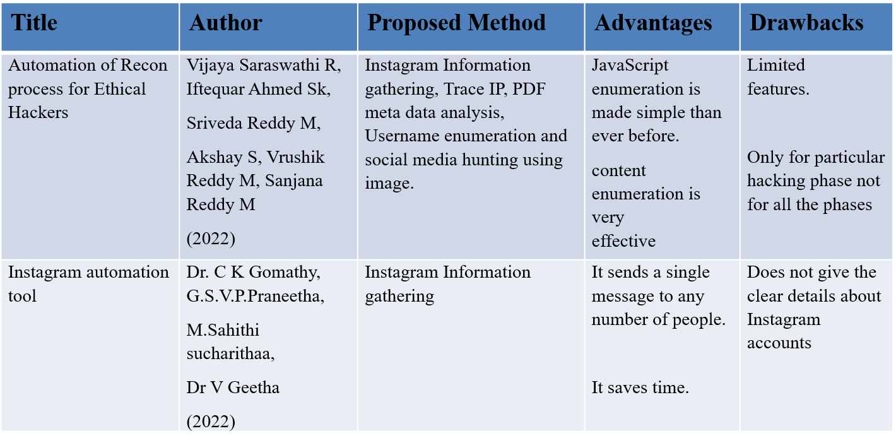
Literature Survey

Slide 11
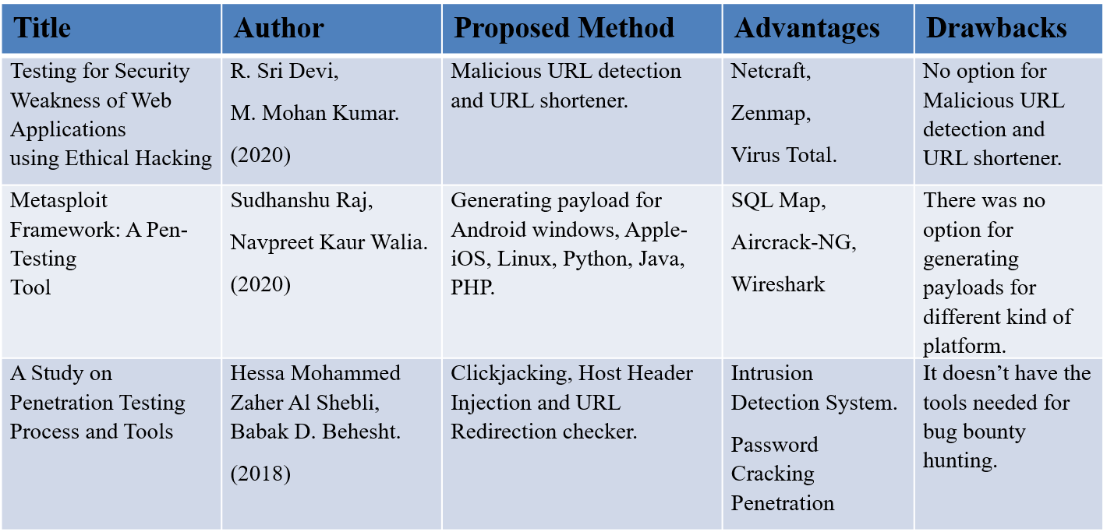

Slide 12
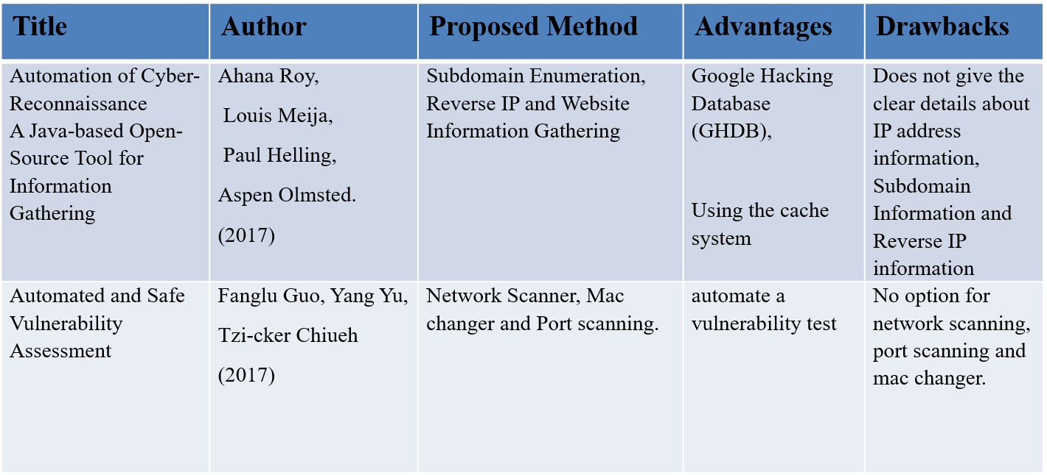

Slide 13
System Architecture Diagram
For system developers, they have system architecture diagrams to know, clarify, and communicate concepts regarding the system structure and also the user needs that the system should support.
It's a basic framework may be used at the system designing section serving to partners perceive the architecture, discuss changes, and communicate intentions clearly.

Slide 14
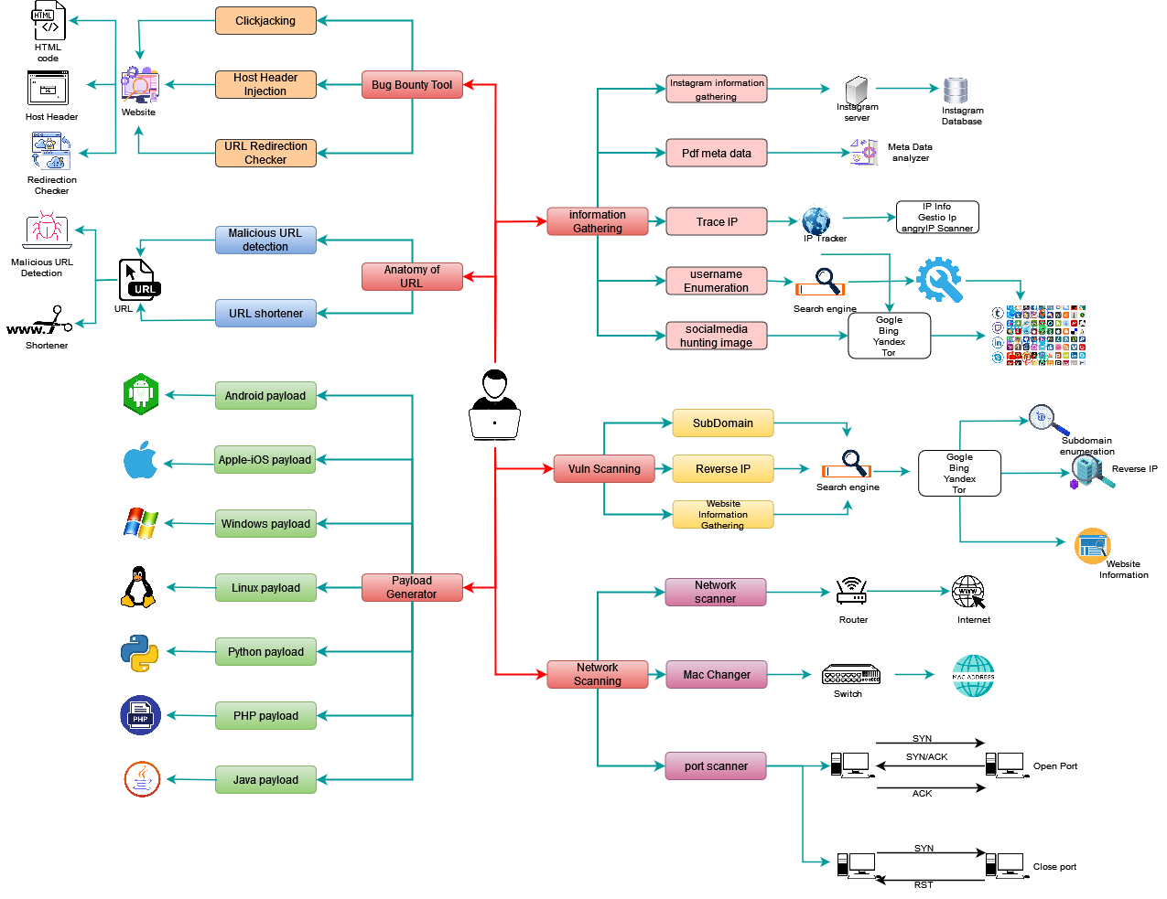
Architecture Diagram

Slide 15
    MODULES
    Information Gathering
      Instagram Information gathering
      Trace IP
      PDF meta data analysis
      Username enumeration
    Website vulnerability scanning
      Subdomain Enumeration
      Reverse IP
      Website Information Gathering

Slide 16
    Network scanning
      Network Scanner
      Mac changer
      Port scanning
    Bug Bounty tool
      Clickjacking
      Host Header Injection
      URL Redirection checker
    Anatomy of URL
      Malicious URL detection
      URL shortener

Slide 17
    Payload Generator
      Android Payload Generator
      windows Payload Generator
      Apple-iOS Payload Generator
      Linux Payload Generator
      Python Payload Generator,
      Java Payload Generator
      PHP Payload Generator

Slide 18
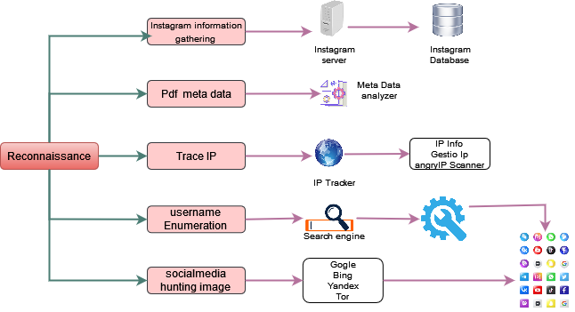
Architecture Diagram

Slide 19
Reconnaissance
This is the first step of Hacking. It is a set of technique like Footprinting, scanning, enumeration. The goal of reconnaissance phase is identifying and gathering information about target.
In reconnaissance phase this tool contain options are:
1) Instagram Information Gathering
  Tool gets a range of information from an Instagram account
The information includes:
  User id, followers/following, number of uploads, profile image URL, business enum, external URL, joined Recently, etc.
2) Trace IP
  Lookup details about an IP address including location, ISP, hostname, type, proxy, blacklist status

Slide 20
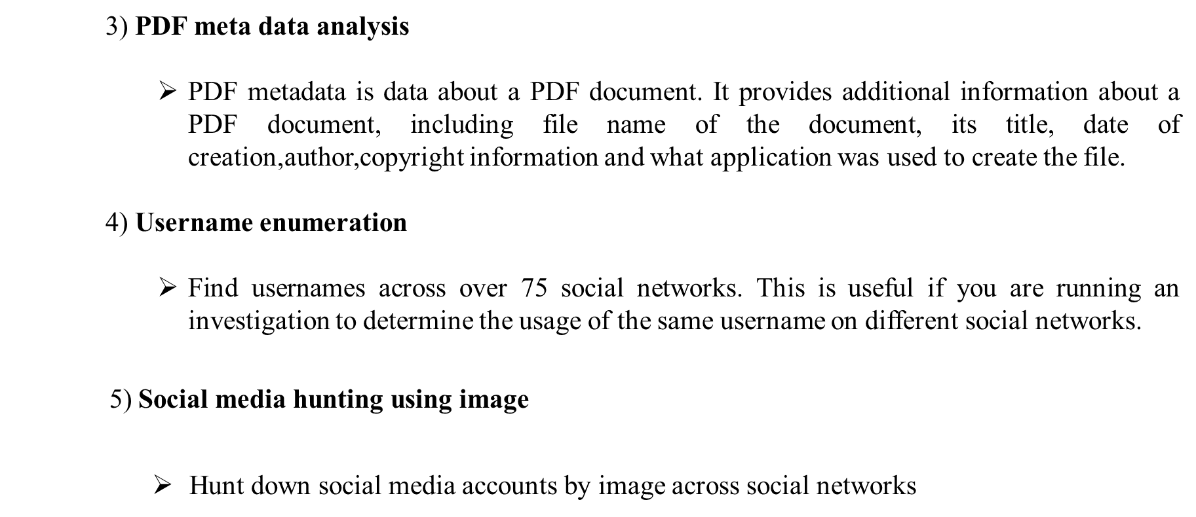

Slide 21
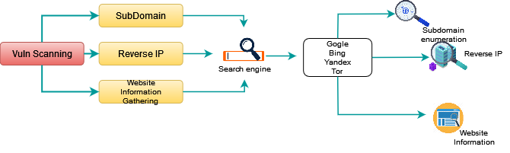
Architecture Diagram

Slide 22
Website vulnerability scanning
The second step in the hacking methodology is scanning, collective more information using complex and aggressive reconnaissance. Vulnerability scanning is identifying vulnerabilities and weak points in a target.
In website vulnerability scanning phase this tool contain options are
1) Subdomain Enumeration
    Subdomain enumeration is the process of finding valid subdomains for one or more domain
2) Reverse IP
    Reverse IP lookup also known as reverse DNS lookup, is the process of querying the DNS to determine the domain name associated with an IP address
3) Website Information Gathering
    Finding website information like DNS servers, IP addresses, mail servers, SPF information, open ports, and more.

Slide 23
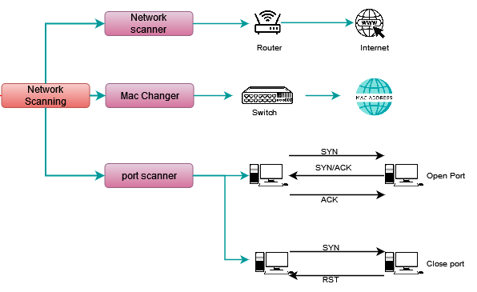
Architecture Diagram

Slide 24
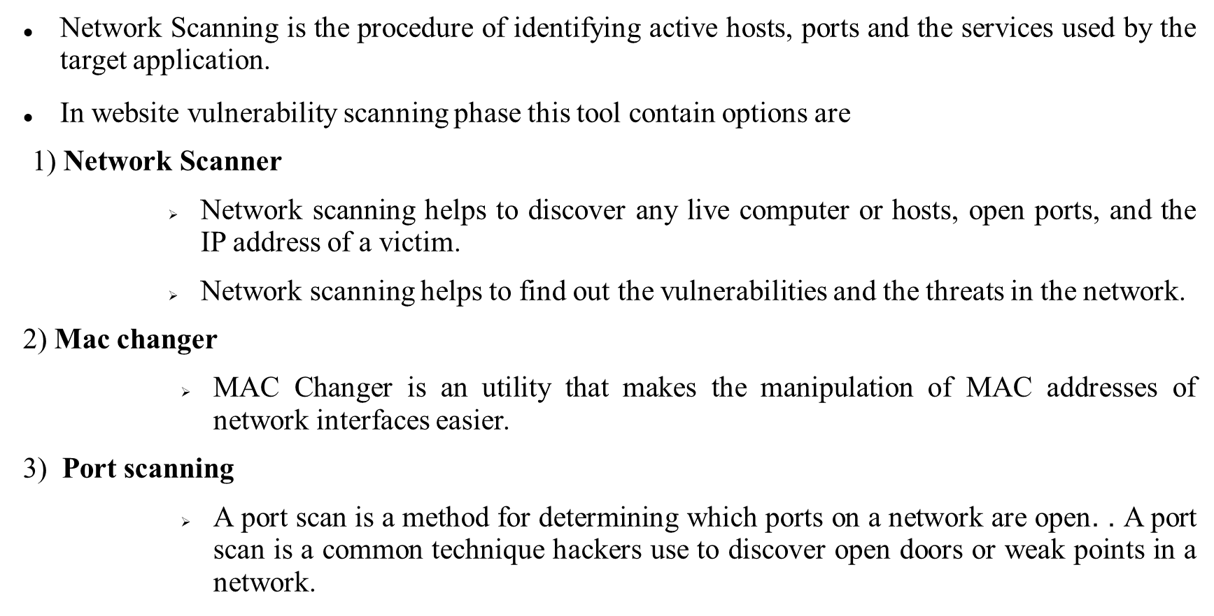
Network scanning

Slide 25
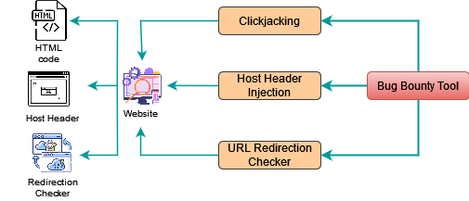
Architecture Diagram

Slide 26
Anatomy of URL:
URL stands for Uniform Resource Locator. A URL is nothing more than the address of a given unique resource on the Web
In Anatomy of URL phase this tool contain options are
1. Malicious URL detection:
The technology of malicious URL detection can help users identify malicious URL and prevent users from being attacked by malicious URL.
Also users get more details about URL like IP address, server, content type, status code, page size, spamming, malware, phishing, suspicious, risk score, category, etc.
2. URL shortener:
A URL shortener is a tool that creates a short, unique URL that will redirect to the specific website of your choosing.

Slide 27
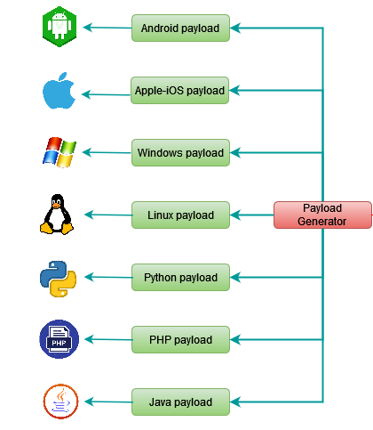
Architecture Diagram

Slide 28
Payload Generator:
It has the option for generating payloads for different kind of platform like Windows, Linux, iOS, Python, PHP, Java.
Payload are malicious scripts that an attacker uses to interact with a target machine in order to compromise it.
A payload is a piece of code that executes when hackers exploit a vulnerability. In other words, it's an exploit module.
In Payload Generator phase this tool contain options are
1. Android Payload Generator:
Used to create payload for android devices, payload in application format
2. Apple-iOS Payload Generator:
Used to create payload for apple-iOS devices, payload in iOS format

Slide 29
3. Windows Payload Generator:
Used to create payload for windows devices, payload in executable format
4. Linux Payload Generator:
Used to create payload for Linux devices, Executable and Linkable Format in application format
5. Python Payload Generator:
Used to create payload for python-based devices, payload in python format
6. PHP Payload Generator:
Used to create payload for PHP-based devices, payload in PHP format
7. Java Payload Generator:
Used to create payload for windows devices, payload in jar or jdk format

Slide 30
System Requirement and Tools:
Hardware Requirements
    PROCESSOR : Intel I3 and above
    RAM : 4GB RAM
    MONITOR : 15”COLOR
    HARD DISK : 100GB AND ABOVE

Slide 31
System Requirement and Tools:
Software Requirements
    OPERATING SYSTEM : Kali-Linux 2022-1 and above
    ENVIRONMENT : PyCharm 2022.1.1
    LANGUAGE : Python v3

Slide 32
Sample coding
using System.Collections.Generic;
using System.ComponentModel;
using System.Data;
using System.Drawing;
using System.Linq;
using System.Text;
using System.Threading.Tasks;
using System.Windows.Forms;
using System.Net;
namespace WebServerVulnerabilityTester
{
public partial class Get_IPAddress_and_other_Website : Form

Slide 33
from instagramy import InstagramUser
from urllib.request import urlopen
from termcolor import colored
from bs4 import BeautifulSoup
from datetime import datetime
import scapy.all as scapy
from requests import get
from halo import Halo
import pyshorteners
import subprocess
import pyfiglet
import requests
import PyPDF2
import codecs
import socket
import urllib
import json
import time
import sys
import os

Slide 34
def iplocate():
try:
print("\t\t\b!!!!............Trace Single IP............!!!!\n\n")
print(red + """ ¶¶¶
¶¶_¶¶¶¶
¶¶____¶¶¶
¶¶¶______¶¶
¶¶¶_______¶¶
¶¶¶¶________¶¶
¶_¶¶_________¶¶
¶__¶¶_________¶¶____¶¶
¶__¶¶__________¶¶¶¶¶¶¶
¶¶__¶¶¶______¶¶¶¶¶¶___¶
¶¶___¶¶__¶¶¶¶¶¶__¶¶
¶¶_¶____¶¶¶¶________¶¶
¶¶__¶¶___¶¶__________¶¶
¶____¶¶___¶¶__________¶¶
¶¶_______¶¶___¶¶_________¶¶
¶¶¶¶¶¶¶¶¶¶¶¶¶__¶¶_________¶
¶¶¶¶¶¶¶¶¶¶¶¶¶¶¶¶¶_¶¶________¶¶

Slide 35
.------.------.
+-------------+ ___ | | |
| | \ /] | | |
| | _ _(_) | | |
| | ___)) [ | \___ | | |
| | ) //o | | \ | | |
| | _ (_ > | | ] | | |
| __ | (O) \__< | | ____/ '------'------'
| / o| [/] / \) [__|/_
| | [\]| ( \ __/___\_____
| | [/]| \ \__ ___| |
| | [\]| \___E/%%/|____________|_____
| | [/]|=====__ (_____________________)
| | [\] \_____ \ | |
| | [/========\ | | |
| | [\] []| | | |
| | [/] []| |_ | |
| | [\] []|___) | |
====================================================================""")

Slide 36
Conclusion
In conclusion, the future enhancements outlined for the Kali Linux Comprehensive Hacker's Toolbox represent a significant step forward in advancing its capabilities for penetration testing and ethical hacking. By integrating machine learning, expanding support for emerging technologies like IoT and blockchain, and enhancing automation and reporting features, Kali Linux will become even more versatile and effective in identifying and mitigating security vulnerabilities.
These enhancements not only empower security professionals with cutting-edge tools but also contribute to the ongoing efforts to strengthen cybersecurity across various industries. With Kali Linux at the forefront of ethical hacking and security testing, organizations can better protect their systems and data from evolving cyber threats.
Overall, the continued development and refinement of the Kali Linux Comprehensive Hacker's Toolbox reaffirm its position as a leading platform for ethical hackers, penetration testers, and security researchers worldwide.

Slide 37
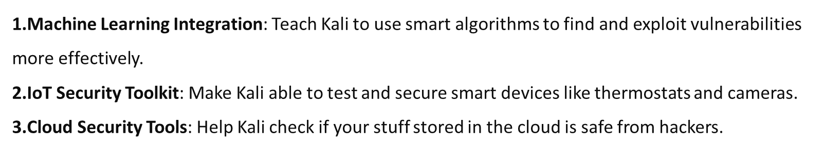
Future Enhancement
Every tool has its own merits and demerits. The project has covered almost all the requirements. Further requirements and improvements can easily be done since the coding is mainly structured Changing the existing modules or adding new modules can append improvements.
By incorporating these enhancements, the Kali Linux Comprehensive Hacker's Toolbox can evolve into a more versatile and powerful platform for conducting advanced penetration testing and ethical hacking across diverse environments and technologies.

Slide 38
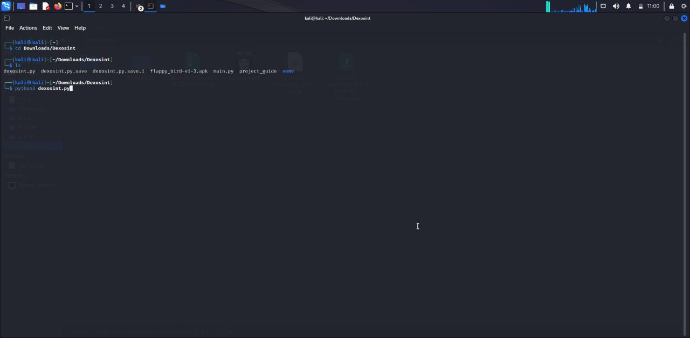
SAMPLE OUTPUT

Slide 39
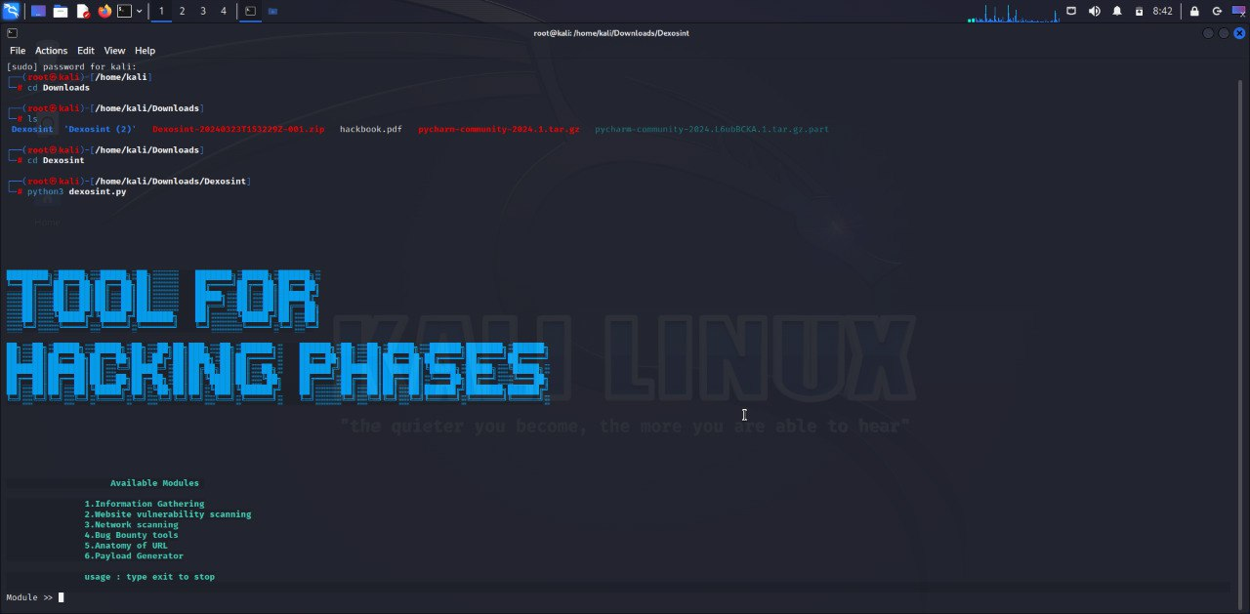

Slide 40
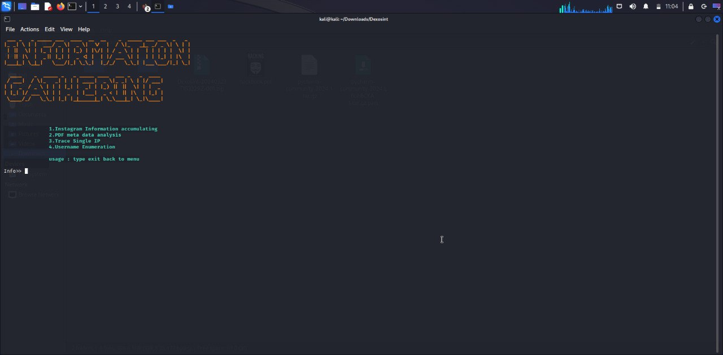

Slide 41
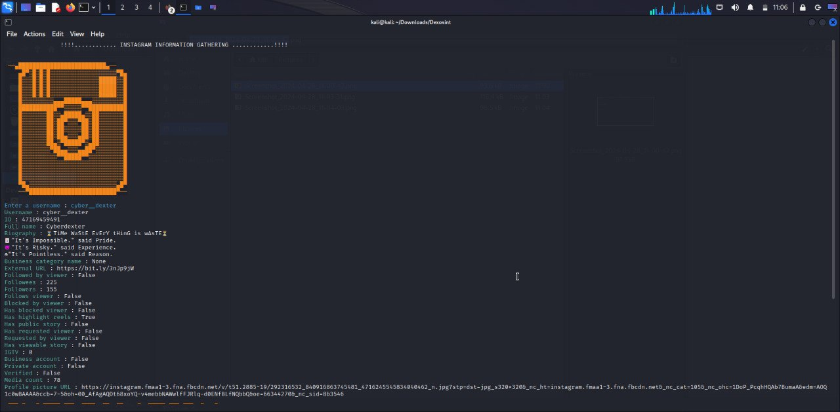

Slide 42
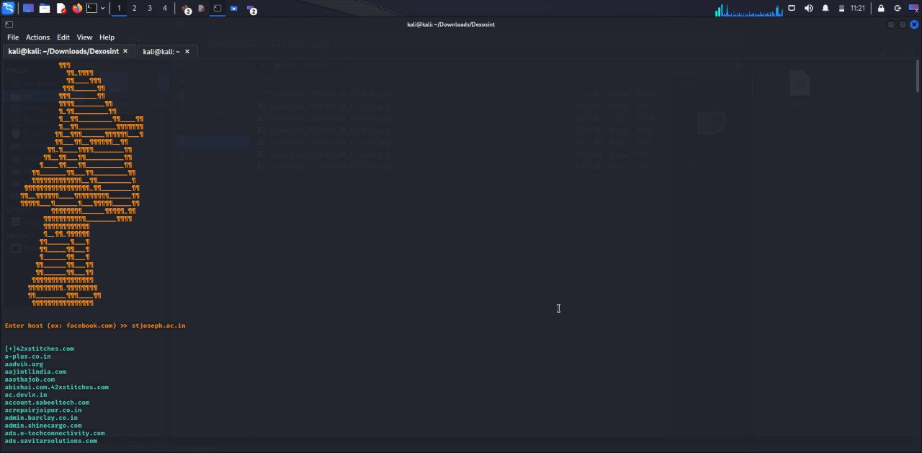

Slide 43
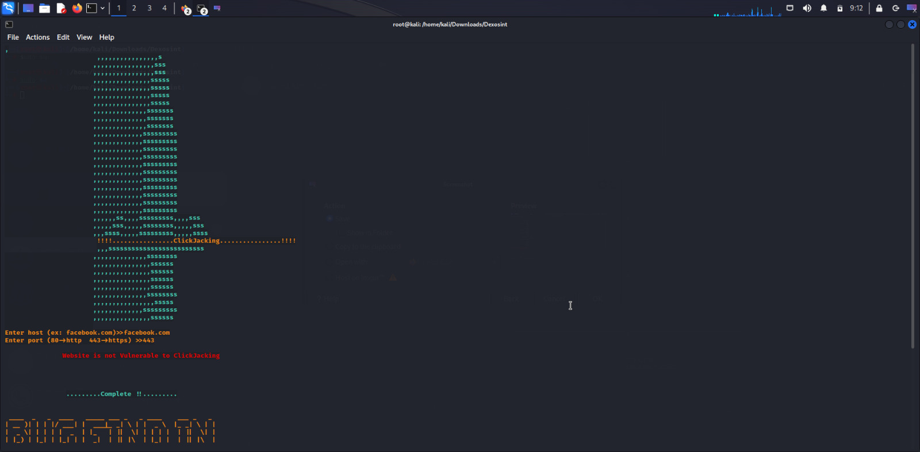

Slide 44
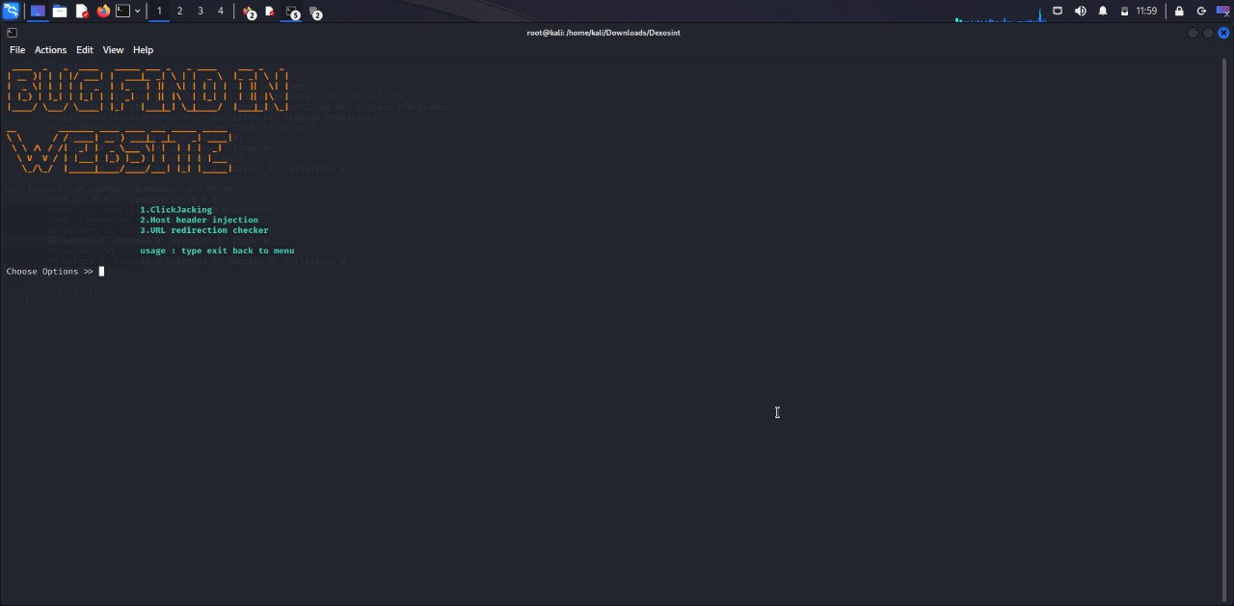

Slide 45
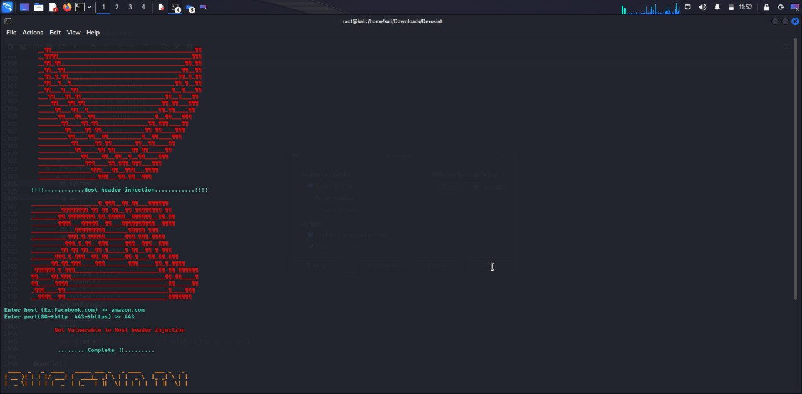

Slide 46
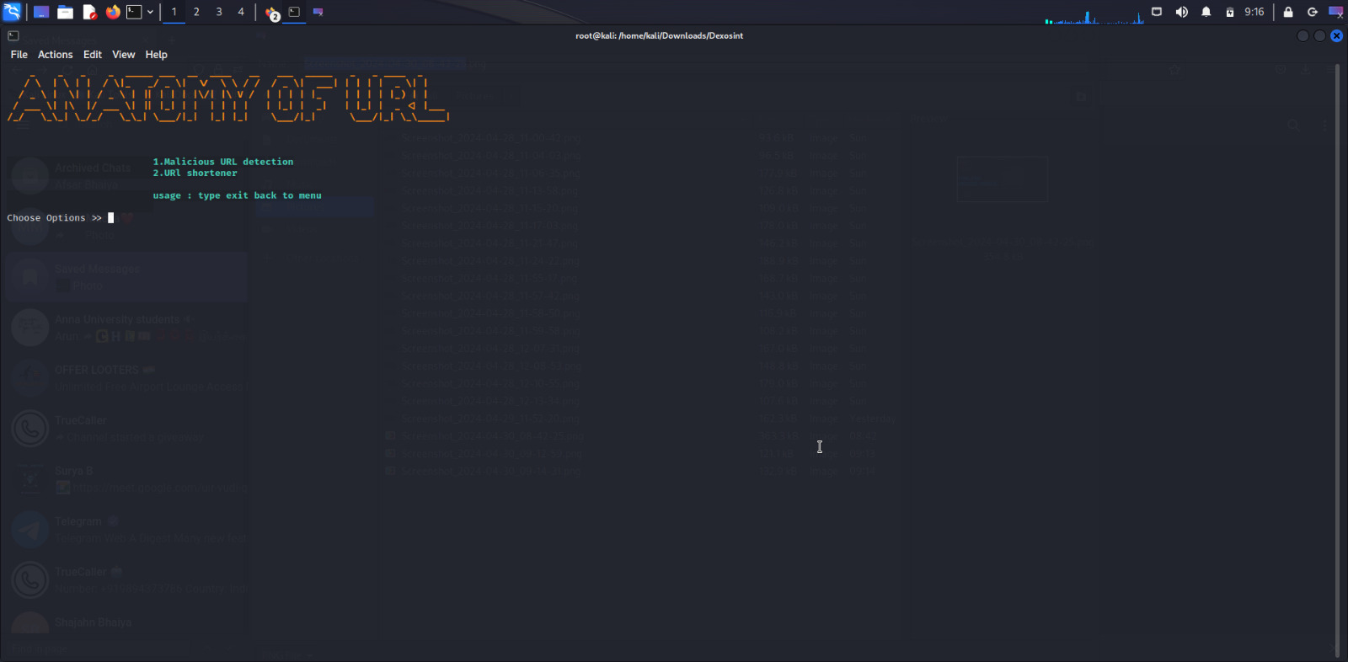

Slide 47
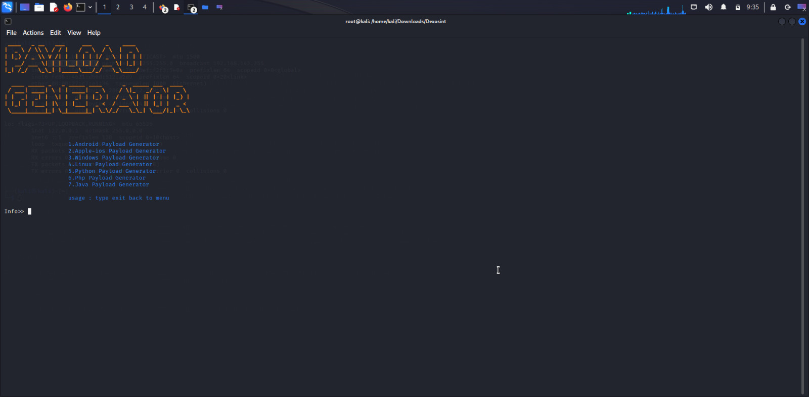

Slide 48
Reference
    A. Tabasum, Z. Safi, W. AlKhater and A. Shikfa, "Cybersecurity issues in implanted medical devices", Proc. Int. Conf. Comput. Appl. (ICCA), pp. 1-9, Aug. 2018.
    F. Harrou, B. Bouyeddou, Y. Sun and B. Kadri, "Detecting cyber-attacks using a CRPS-based monitoring approach", Proc. IEEE Symp. Ser. Comput. Intell. (SSCI), pp. 618-622, Nov. 2018.
    Software-Defined Networking, Apr. 2020, [online] Available: https://www.cisco.com/c/en/us/solutions/software-defined-networking/overview.html.
    Pentesting on web applications using ethical – hacking Rina Elizabeth López de Jiménez 2016 IEEE 36th Central American and Panama Convention.

Slide 49
Reference
    “Ethical Hacking and Penetration Testing Guide”Originally published: 2014, Rafay Baloch.
    “Hacking Tool Identification in Penetration Testing” Da-Yu Kao;Yun-Ya Chen;Fuching Tsai 2020 22nd International Conference on Advanced Communication Technology (ICACT).
    Allen Harper, Shon Harris, Jonathan Ness,Chris Eagle, Gideon Lenkey, and Terron Williams “Gray Hat Hacking”.
    "Automation of Recon Process for Ethical Hackers" Vijaya R Saraswathi;Iftequar Sk Ahmed;Sriveda M Reddy;S Akshay;Vrushik M Reddy;Sanjana M Reddy 2022 International Conference for Advancement in Technology (ICONAT).
    Lwin Khin Shar; Briand, L.C.; Hee Beng Kuan Tan, "Web Application Vulnerability Prediction Using Hybrid Program Analysis and Machine Learning", Dependable and Secure Computing, IEEE Transactions Year: 2015, Volume: 12, Issue: 6 Pages: 688 – 707.

Slide 50
Reference
    Vlsaggio, C.A.; Blasio, L.C., "Session management vulnerabilities in today's web" Security & Privacy IEEE Year: 2010, Volume: 8.
    Palma Salas, M.I.; Martins, E. "A Black-Box Approach to Detect Vulnerabilities in Web Services Using Penetration Testing", Latin America Transactions, IEEE (Revista IEEE America Latina) Year:2015, Volume: 13.
    "An automated approach to Vulnerability Assessment and Penetration Testing" using Net-Nirikshak 1.0 Sugandh Shah;B.M. Mehtre 2014 IEEE International Conference on Advanced Communications, Control and Computing Technologies

Slide 51
THANK YOU!

